Slide 1





Command Line
<InfPALS/>

Slide 2
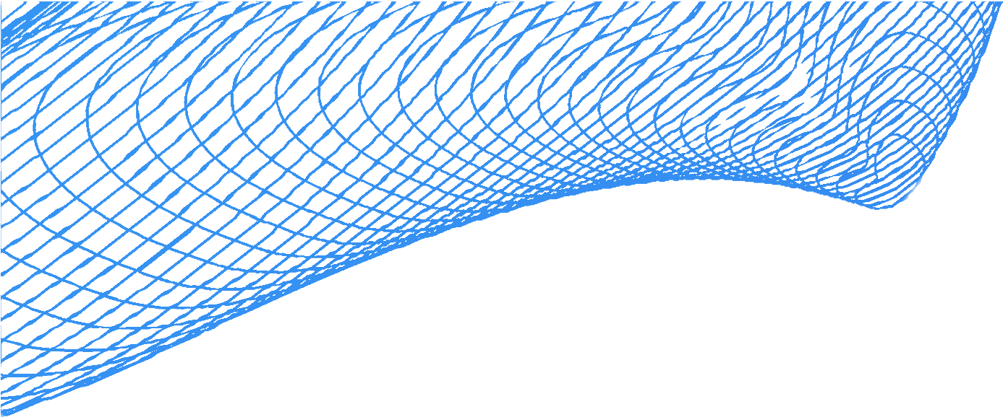


SHELL
The program that runs the supported
command line instructions.
Allows users/other programs to access functionalities provided by the OS through a text interface
Comes with different variants
  bash, zsh, cmd, powershell…
  The one we are going to focus on is bash, a shell that was designed for linux/unix systems
Folder
File

Slide 3


Install Git Bash
Go to https://gitforwindows.org/
2. Click Download
3. Follow the install instructions (you shouldn’t need to change anything)
4. Open git bash
5. Alternative simulator: https://terminaltemple.com
If you are a Mac user, just use your terminal.
Windows does not natively provide a BASH terminal. Some commands will work in PowerShell, and some can even be used in CMD if you translate from UNIX based commands, but not all.
For the purposes of the workshop, we will install a BASH emulator called Git bash. Not only is this a simple UNIX shell, it will also be required for the git workshops! (Git)
Folder
File

Slide 4
Command Lines
The set of Instructions that are supported by shell
When we are connecting to the computer we are connecting to tree-like structure of files and folders
Folder
File

Slide 5

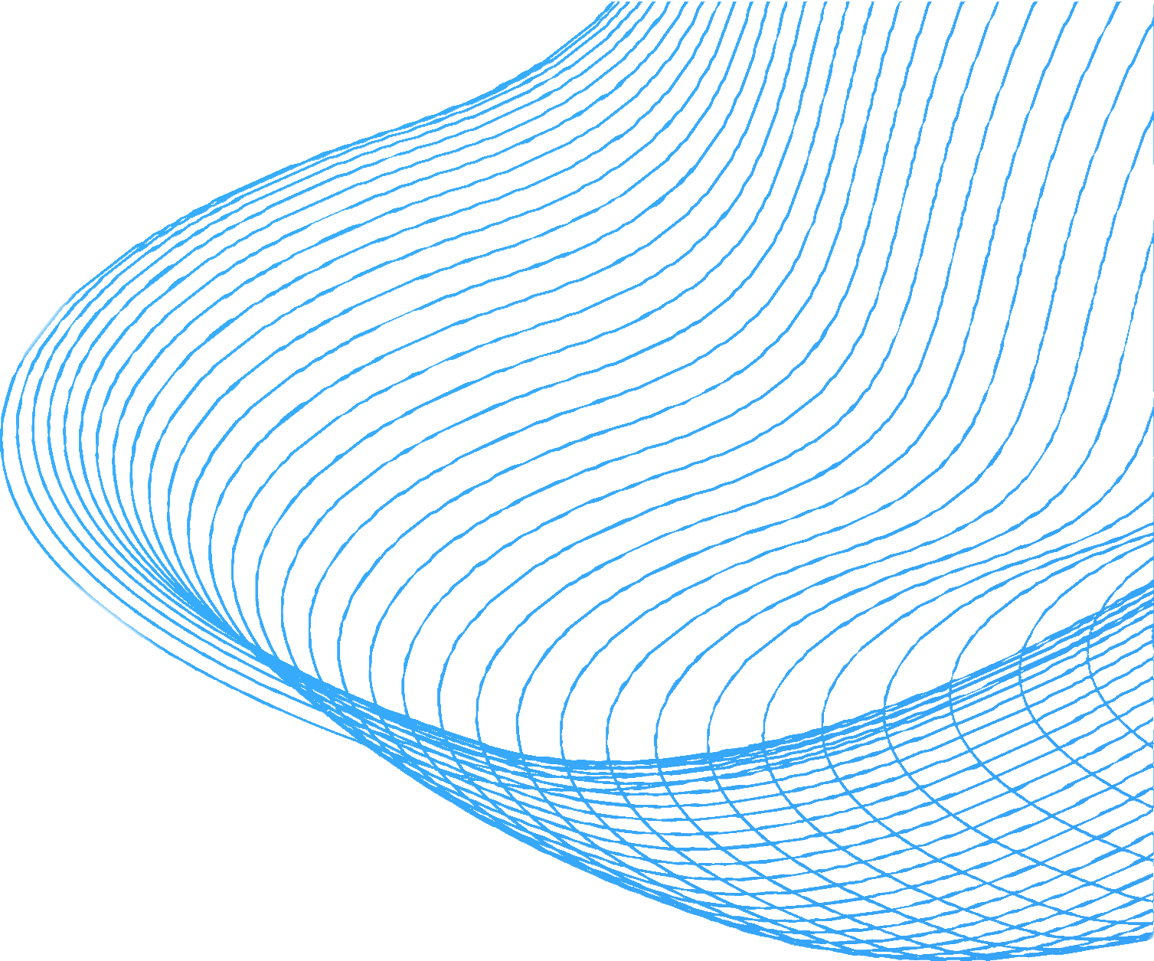

WHY WE NEED IT?
GUI not always available but CLI is
Interaction with Git and Github (through git bash commands)
More control over your machine
Automation of many repetitive tasks (shell scripts)

Slide 6

COMMAND STRUCTURE
command -options arguments
Options:
How the command behaves (any special cases)
Arguments:
On what files/folders the command executes its function

Slide 7
WHAT COMMANDS ARE WE GOING TO LEARN?
pwd
ls
cd
mkdir
touch
mv
sleep
rm -[rf]
man / help
echo
nano
cat
ssh
ps

Slide 8



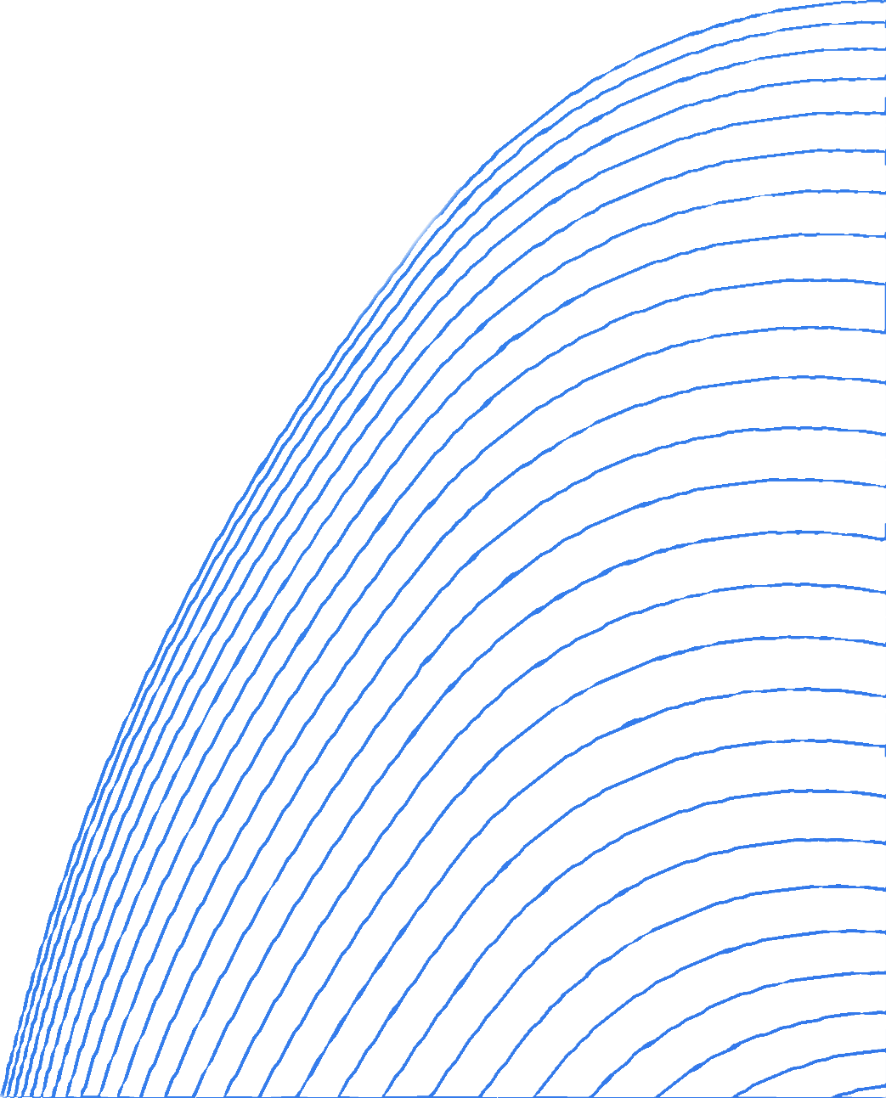
LET'S OPEN THE TERMINAL

Slide 9

PWD
Prints the path to the working / current directory (where you currently are)
Path can be also seen as a list of all of the folders in which you are currently located
Terminal can only be open in Folder
Example: pwd
In Windows: cd
You are here
Folder
File

Slide 10

LS
List the current content of your directory (folder)
You are here
Example: ls Optional: ls -a
In Windows: dir
Folder
File

Slide 11


CD [DIR]
You are here
Move between Directories (Folders)
To specify the directory: List
the whole path
just the folder name (this can be only done if you are one above the folder)
You are here
Example: cd Folder1 Optional: cd ~ or cd /

Slide 12


MKDIR
You are here
Creates one or more Directories (Folders)
You are here
Example: mkdir Folder1
mkdir Folder1 Folder2
New
New

Slide 13


TOUCH
You are here
Creates one or more Files
You are here
Example: touch File1
touch File1 File
In Windows: type nul > File.txt
New
New

Slide 14


MV
You are here
Moving File
2 Functionalities:
Rename Folder or File
You are here
2. Move Folder or File
Example: mv File1 File2
mv File1 Folder1/
Windows: ren File2 File2
move File1 File2/
Moving File

Slide 15

RM
You are here
File for Deletion
File for Deletion
Deletes one or more Files
You are here
Example: rm File1
rm File1 File2
in windows: del file1 file2

Slide 16

RM - RF
You are here
``
Folder for Deletion
Deletes a Directory (Folder) and all of Files and Folders in it
You are here
Example: rm -rf Folder1
In windows: rmdir /s Folder1

Slide 17


MAN / HELP
Prints out documentation related to a given command
To exit, press q
Example: man cd

Slide 18




NANO
Simple Text Editor which can be opened in Terminal
This is used to make quick edits to text files
Example: nano

Slide 19
CAT
Functionalities:
Create a new file
View file contents
Edit the file contents (write, append)
ConcAtenaTe
Example: cat >file1.txt (create)
cat file1.txt (view)
cat file1.txt > file2.txt (write)
cat file1.txt >> file2.txt (append)
cat >> file1.txt (append from terminal)

Slide 20



SSH
SSH (Secure Shell) is a secure protocol to connect and communicate with remote computers or servers
It uses encryption to protect all data sent between computers, making it safe to use over the internet
It can be used to connect to the university DICE machines and work remotely from your personal computer!
Example: ssh username@student.ssh.inf.ed.ac.uk

Slide 21
Others
Sleep
ps
&
kill
fg and bg
clear
CTRL+C
CTRL+Z

Slide 22




TIME FOR EXERCISES
IF YOU NEED ANY HELP DO NOT HESITATE TO ASK :)

Slide 23
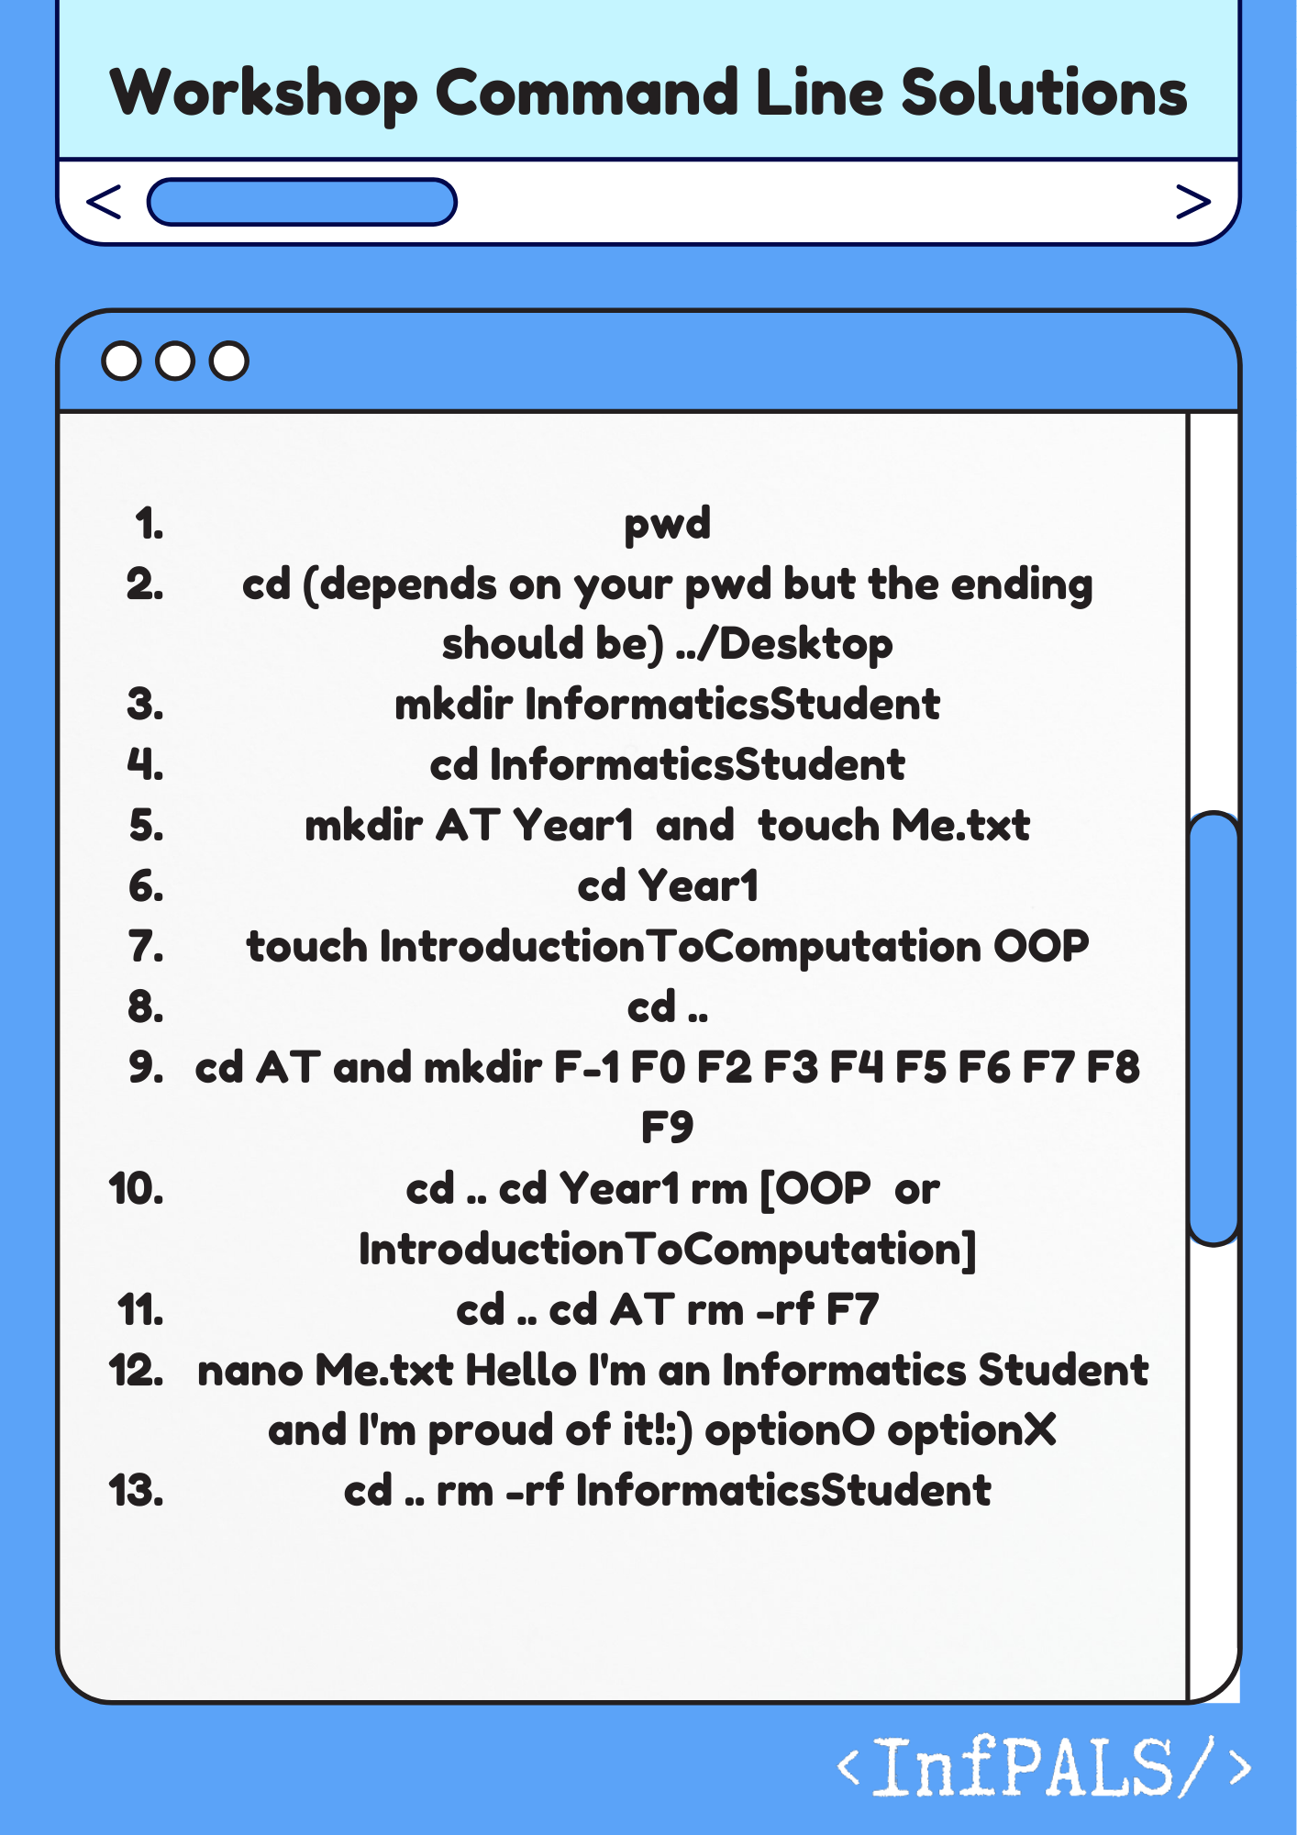

Slide 24


EXERCISES
Print path to your current dir
Move to the Desktop dir
Create dir InformaticsStudent
Move into InformaticsStudent
Create dirs Year1, AT and file Me.txt
Move into Year1
Create files for each Informatics course you are taking in Year1
Move back to InformaticsStudent
Move to AT and create dir for each floor of AT
10. Move to Year 1, delete a file with a subject you liked the most and move the remaining file to InformaticsStudent
11. Move to AT and delete the folder corresponding to the floor we are on
12. Rename AT to AppletonTower
13. Write into Me.txt through the command line: "Hello I'm an Informatics Student and I'm proud of it! :)" (Hint: use nano)
14. Optional: Move to Desktop and delete InformaticsStudent
Notes:
pwd
cd (depends on your pwd but the ending should be) ../Desktop
mkdir InformaticsStudent
cd InformaticsStudent
mkdir AT Year1 and touch Me.txt
cd Year1
touch IntroductionToComputation OOP
cd ..
cd AT and mkdir F-1 FO F2 F3 FS F6 F7 F8 F9
cd .. cd Year1 rm [OOP or IntroductionToComputation]
cd .. cd AT rm -rf F7
nano Me.txt Hello I'm an Informatics Student and I'm proud of it!:) optionO optionX
cd .. rm -rf InformaticsStudent

Slide 25
Extra Knowledge

Slide 26
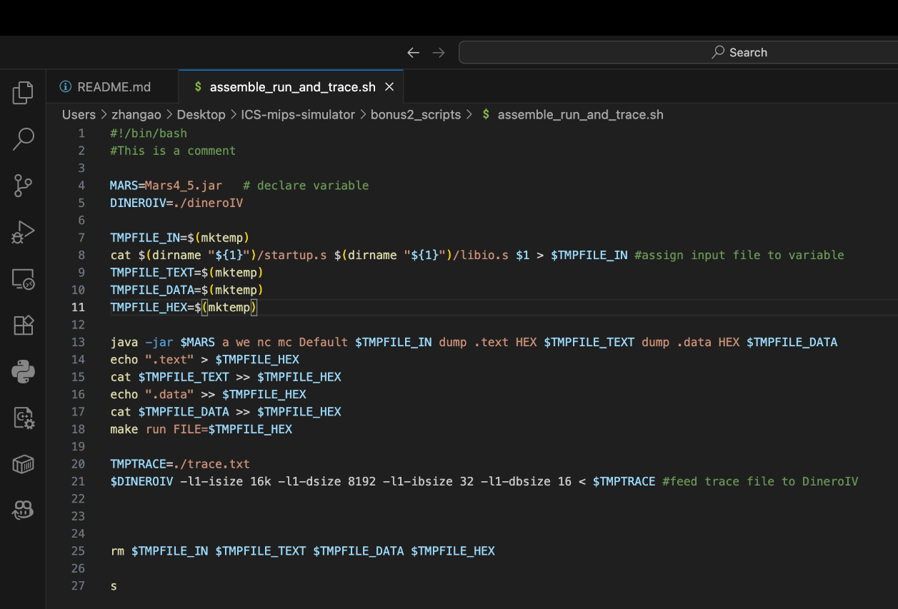
Shell Scripts
You can put multiple lines of command into one file name with .sh to execute all of them in once!
You may need the command
chmod +x script.sh
to give the execution permission to your shell script.
Folder
File

Slide 27
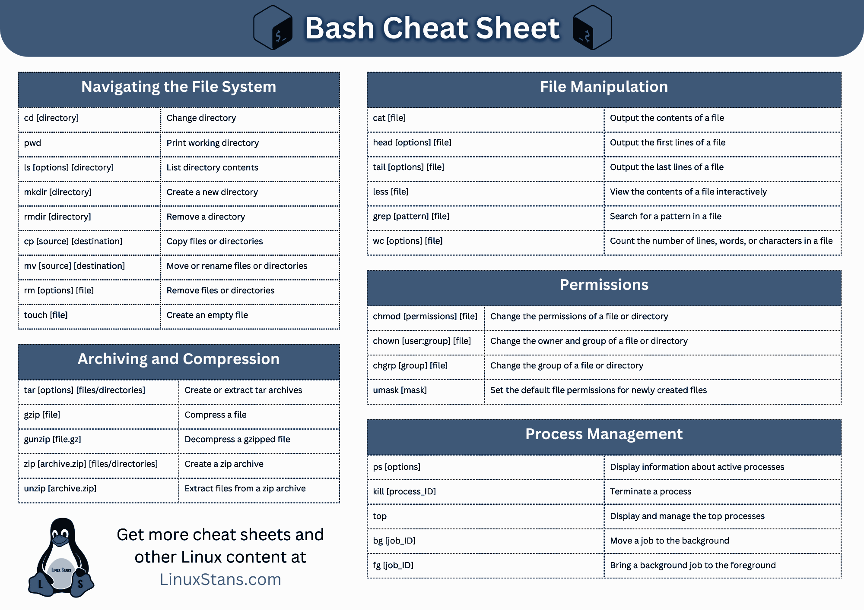
Extra commands
These commands are also useful to know
You can always find their usage on the internet
Folder
File

Slide 28
Thank you for coming!
Check out other upcoming InfPALS sessions:

